Slide 1

Lending Club Case Study
Team members:
Nitin jain
mritunjay singh

Slide 2
Problem Statement
In this case study, you will use EDA to understand how consumer attributes and loan attributes influence the tendency of default.
If the company approves the loan, there are 3 possible scenarios described below else it will be rejected:
Fully paid: Applicant has fully paid the loan (the principal and the interest rate)
Current: Applicant is in the process of paying the instalments, i.e., the tenure of the loan is not yet completed. These candidates are not labelled as 'defaulted'.
Charged-off: Applicant has not paid the instalments in due time for a long period of time, i.e., he/she has defaulted on the loan

Slide 3
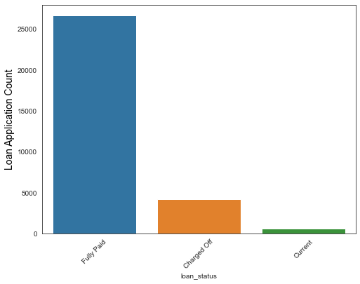
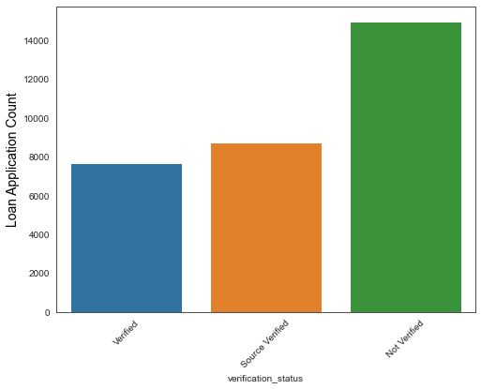
Analysis for categorical data

Slide 4
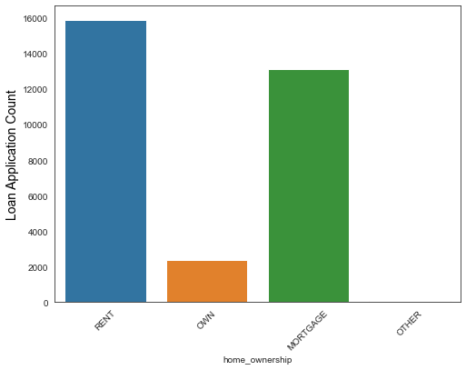
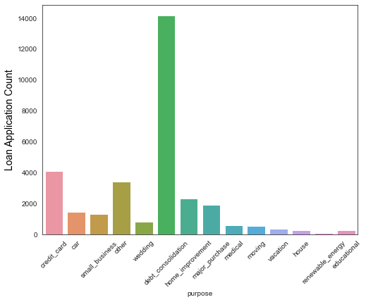
Analysis for categorical data

Slide 5
Observation
Most of the loan application are completed.
Most of the application have not verified their application.
Most of the application have home ownership as rented.
Most of the loan applicant are taking loan for the purpose of debt consolidation and least for the renewable energy.

Slide 6
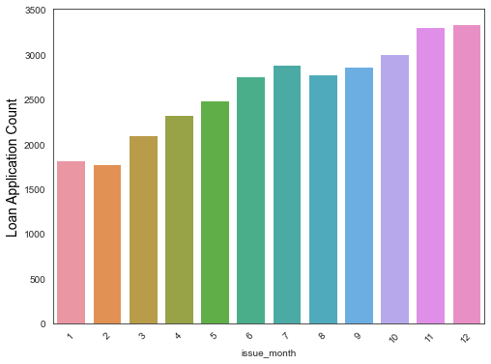
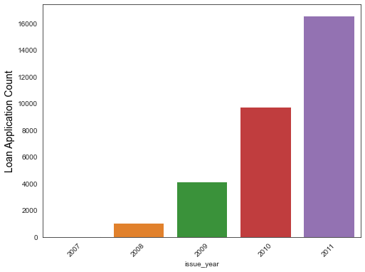
Analysis for numerical data

Slide 7
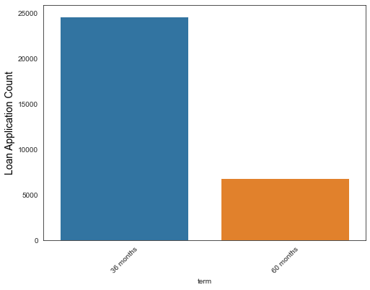
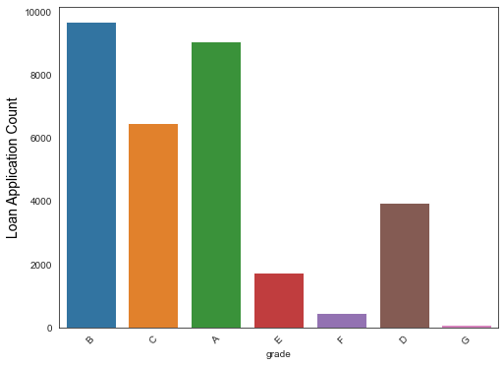
Analysis for numerical data

Slide 8
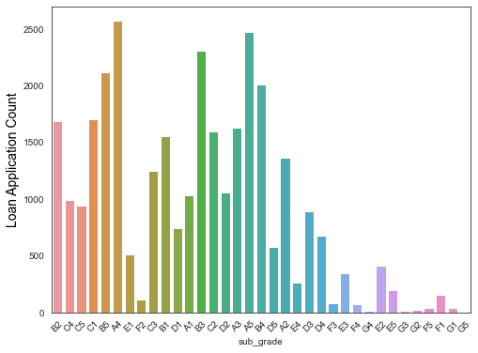
Analysis for numerical data

Slide 9
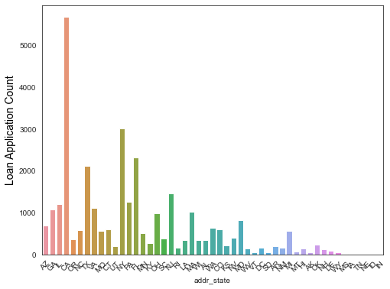
Analysis for numerical data

Slide 10
Observation
In recent years, the loan application have been increased
In the month of oct, nov and dec most of the loans are being issued.
This is due to decrease in the interest rate
There are more applicant who took 36 months duration loan as compared to 60 months.
Most of the applicants belongs to grade A and B
For subgrade same as most of the applicants belong to Grade A and B.
Most of the applicants are from NY and CA.

Slide 11
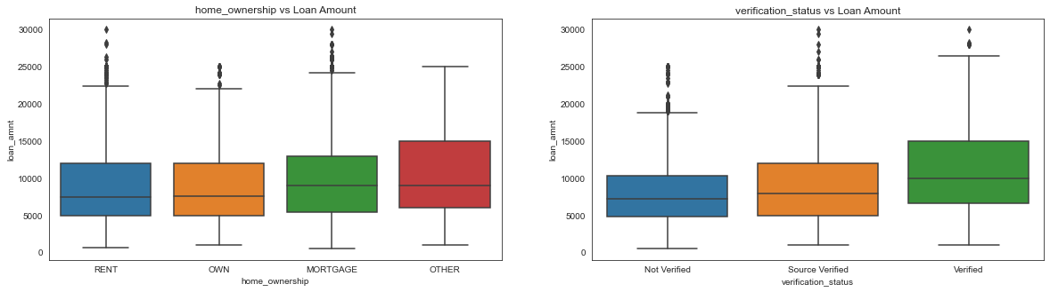
Segmented Analysis

Slide 12
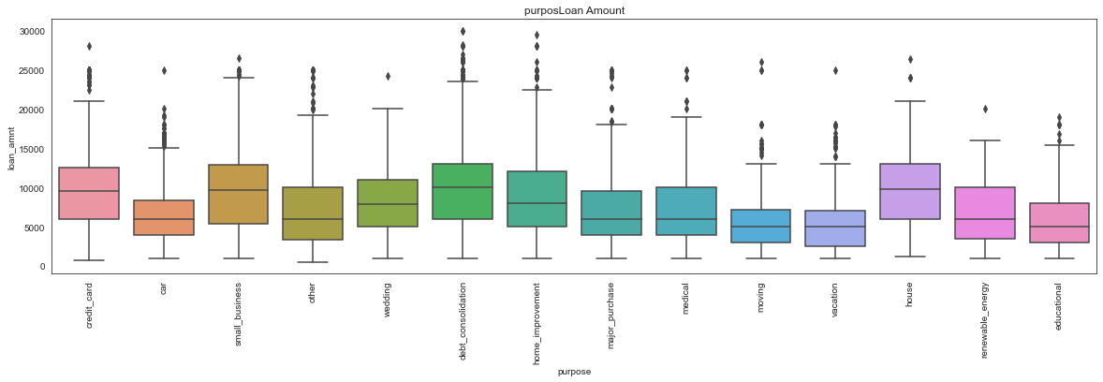
Segmented Analysis

Slide 13
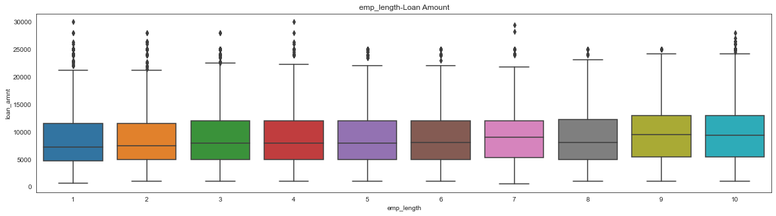
Segmented Analysis

Slide 14
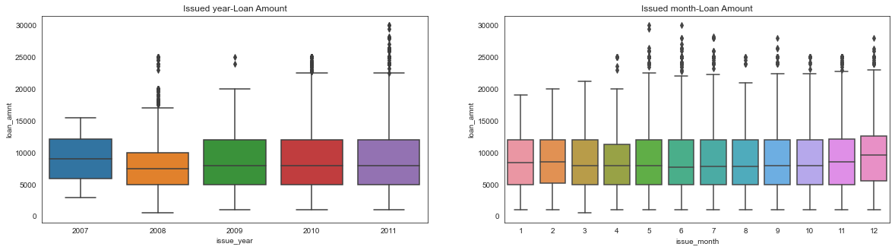
Segmented Analysis

Slide 15
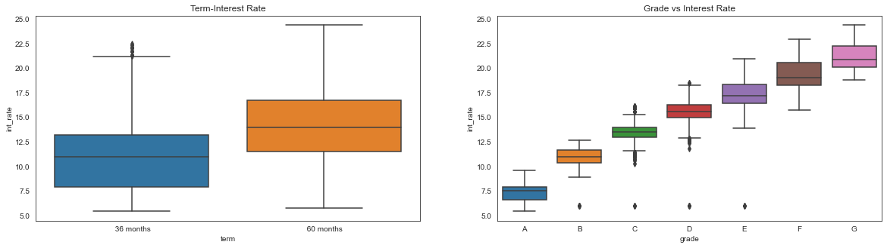
Segmented Analysis

Slide 16
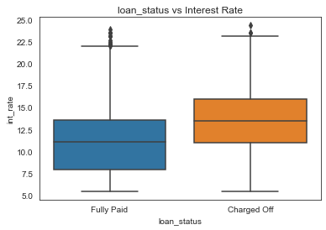
Segmented Analysis

Slide 17
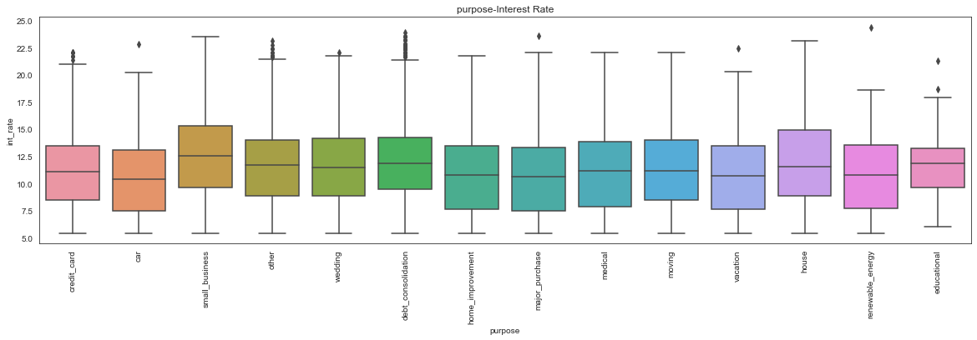
Segmented Analysis

Slide 18
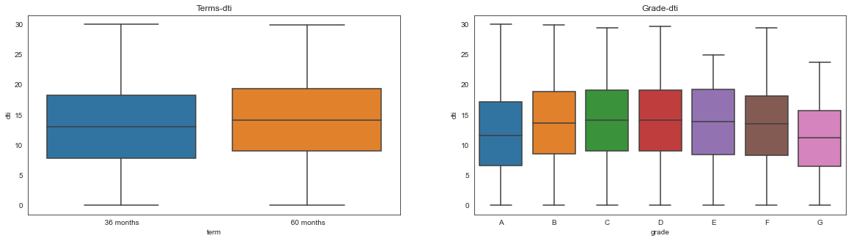
Segmented Analysis

Slide 19
Segmented Analysis

Slide 20
Observation
Most of the loan applicants are having MORTGAGE homeownership.
Most of the borrower have sourced.
Most of the loan amount is for Small business
More applicants who got loan approved are of 10yrs, so less age is the factor to get loan rejected.
More amount of loan is disbursed in year 2011 and in the last three months of the year.
DTI is high 60 months tenure

Slide 21
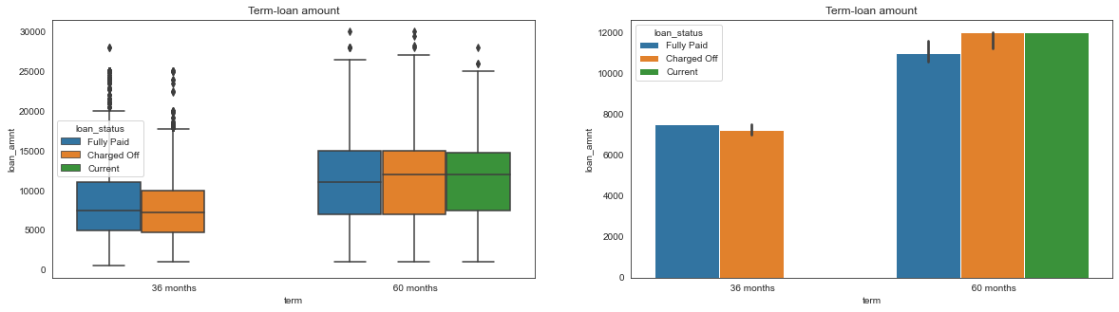
Bivariate Analysis

Slide 22
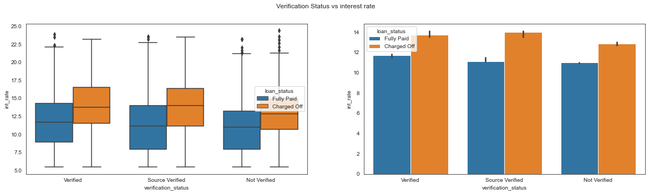
Bivariate Analysis

Slide 23
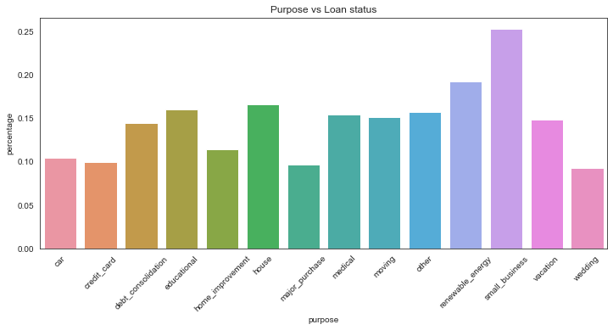
Bivariate Analysis

Slide 24
Observation
More proportion of borrowers defaulted loan in 60 months.
Borrowers with higher employment lengths and took more loan amounts got more default rate.
The interest rate iS POSITIVELY correlated with default rate.
Charged-off are higher for small_business comparitively.
The public derogatory records correlated with public bankruptcies records.
Interest rates are high for people with high revol utilisation

Slide 25
Your best quote that reflects your approach… “It’s one small step for man, one giant leap for mankind.”
- Neil Armstrong

